Slide 1
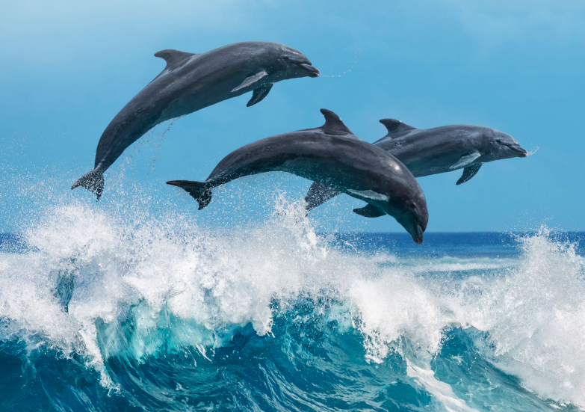
Workshop on Environmental Monitoring and Mitigation around Deployed Marine Energy Devices
Andrea Copping
Pacific Northwest National Laboratory
& OES-Environmental
Ian Hutchison
Aquatera Ltd.
& ORJIP Ocean Energy
Notes:
Andrea

Slide 2
Workshop Agenda
Start Time | Agenda Topic
16:30 | Introductions, Purpose of the workshop
16:45 | Examples of environmental monitoring and mitigation around projects
17:30 | Best practices in monitoring
18:00 | Role of research in supporting monitoring programs, potential for funding
18:20 | Next steps
18:30 | Adjourn
Questions we will address today:
What drives specific monitoring data collection and analysis needs around a deployed device?
What information can help focus these monitoring efforts?
Are there other types of information that might be needed?
How can we deliver this information for good of the sector?

Slide 3
Examples of Environmental Monitoring and Mitigation around Projects
SMEC, Canada
CalWave, US
Voith, Scotland
Meygen, Scotland
Morlais, Wales

Slide 4
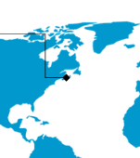
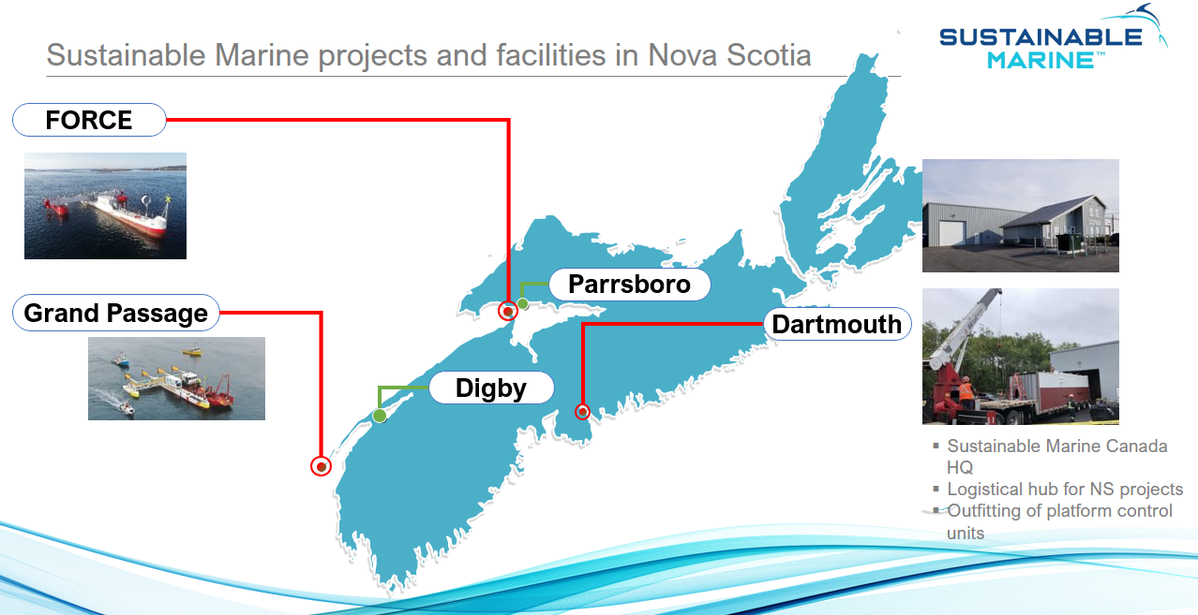
Grand Passage Sustainable Marine Energy (Canada) Ltd.
Developer: Sustainable Marine
Regulator: Fisheries and Oceans Canada (DFO)
Location: Grand Passage, Nova Scotia
Generating capacity: 0.42 MW
Consent status: consent was awarded in 2018, renewed in 2020, 2022

Slide 5
Grand Passage Sustainable Marine Energy (Canada) Ltd.
Mitigation Measures
Collision risk
Daylight only operation; and
Shutdown if Schedule 1 Species at Risk is seen within 100m
Underwater noise
no mitigation measures specified
Benthic impacts
no mitigation measures specified
Other notable mitigation measures
no mitigation measures specified

Slide 6
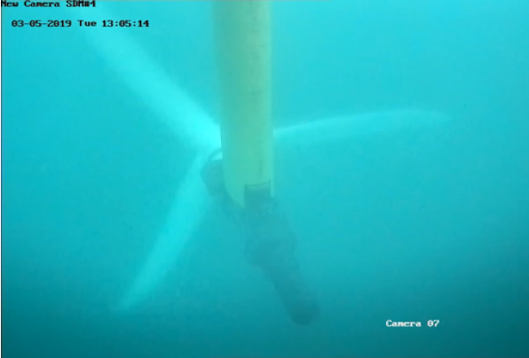
Grand Passage Sustainable Marine Energy (Canada) Ltd.
Monitoring measures
Collision risk
Collection and analysis of underwater video data to observe fish, seabirds, sea turtles, and marine mammals in the near field of the turbine
Collection and analysis of acoustic data to monitor vocalizing marine life
(Voluntary) half-hourly marine animal observation
Underwater noise
Collection and analysis of acoustic data to monitor
marine noise
Benthic impacts
None
Other notable monitoring measures
None

Slide 7
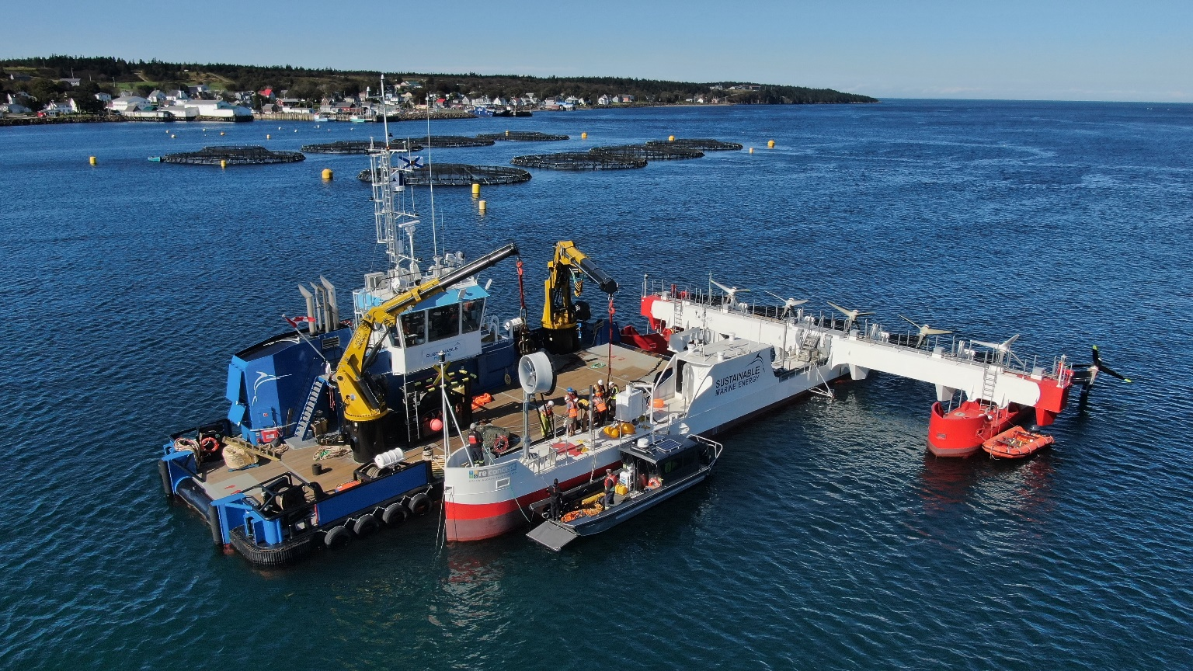
Grand Passage Sustainable Marine Energy (Canada) Ltd.
Reporting requirements:
Collision risk
Quarterly underwater video and hydrophone data analysis and reporting issued to DFO
Underwater noise
Quarterly hydrophone data
analysis and reporting issued
to DFO
Benthic impacts
none
Other notable reporting requirements
none

Slide 8
Grand Passage Sustainable Marine Energy (Canada) Ltd.
Observations:
Mitigation and monitoring measures; what worked well what didn’t go to plan?
Underwater cameras functioned as expected; water clarity is variable
Hydrophone allowed assessment of device noise and detection of vocalizing mammals
Preparing the EMMP and agreeing mitigation and monitoring measures; key challenges and lessons learned:
Proponent proposes plan; some back-and-forth; decision-making somewhat opaque
How mitigation and monitoring activities were funded; private, public, both?
Private initially; some current activities part of research funded by Canadian government

Slide 9
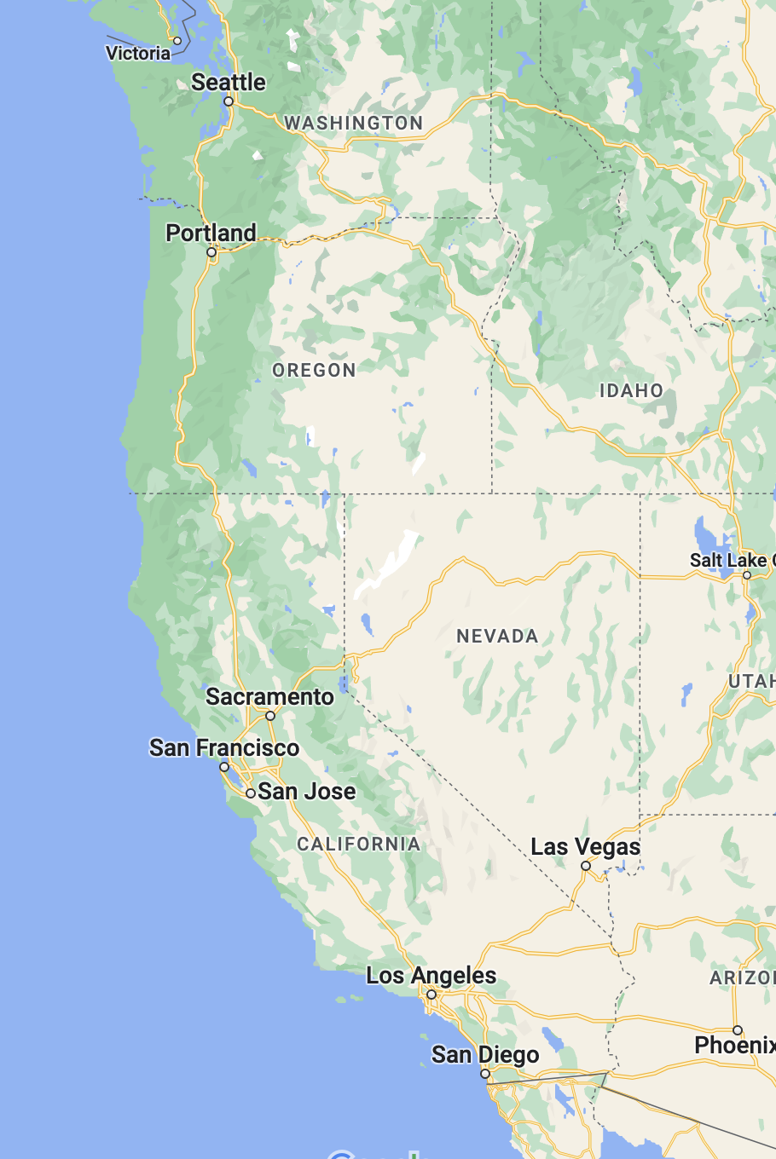
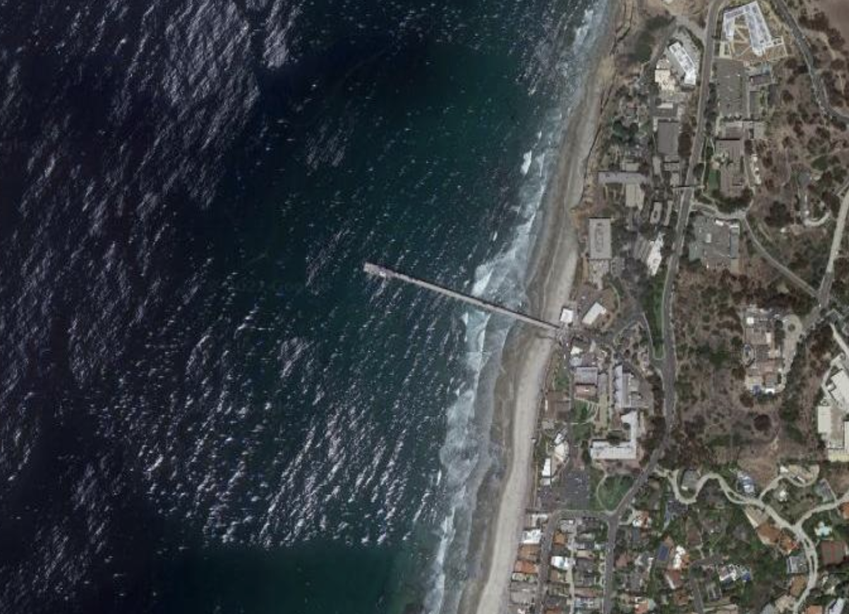
CalWave, California
Developer: CalWave
Regulators: California Department of Fish and Wildlife (DFW), California Water Boards, National Marine Fisheries Service (NMFS), US Army Corps of Engineers (USACE), US Coast Guard Private Aids to Navigation (PATON)
Location: La Jolla, California
Generating capacity: 15 kW
Consent status: consented and reporting complete

Slide 10
CalWave, California
 | Mitigation Measures | Monitoring Measures | Reporting Requirements
Collision Risk | Device motion relative to surrounding wave environment | External onboard camera continuously observing moving components | Any unanticipated impact on ESA-listed species would have required reporting
Underwater Noise | Machinery located inside pressure hull | Drifting (days) and fixed (months) hydrophones | Any unanticipated impact on protected species would have required reporting
Benthic Impacts | Consideration in anchoring selection | 360-degree video camera (days) | Observations of any unanticipated changes from baseline
Other Notables | Taut mooring lines (minimizing entanglement risk) Vessel operations at test site deemed higher risk to marine life than deployed WEC itself | On-device video camera (all duration) Appropriately trained MMOs on board vessels; 500m distance from whales and 100m distance from marine mammals & sea turtles | Marine mammal observations and any unanticipated changes from baseline study Reporting of any suspected entanglement to NMFS would have been required

Slide 11
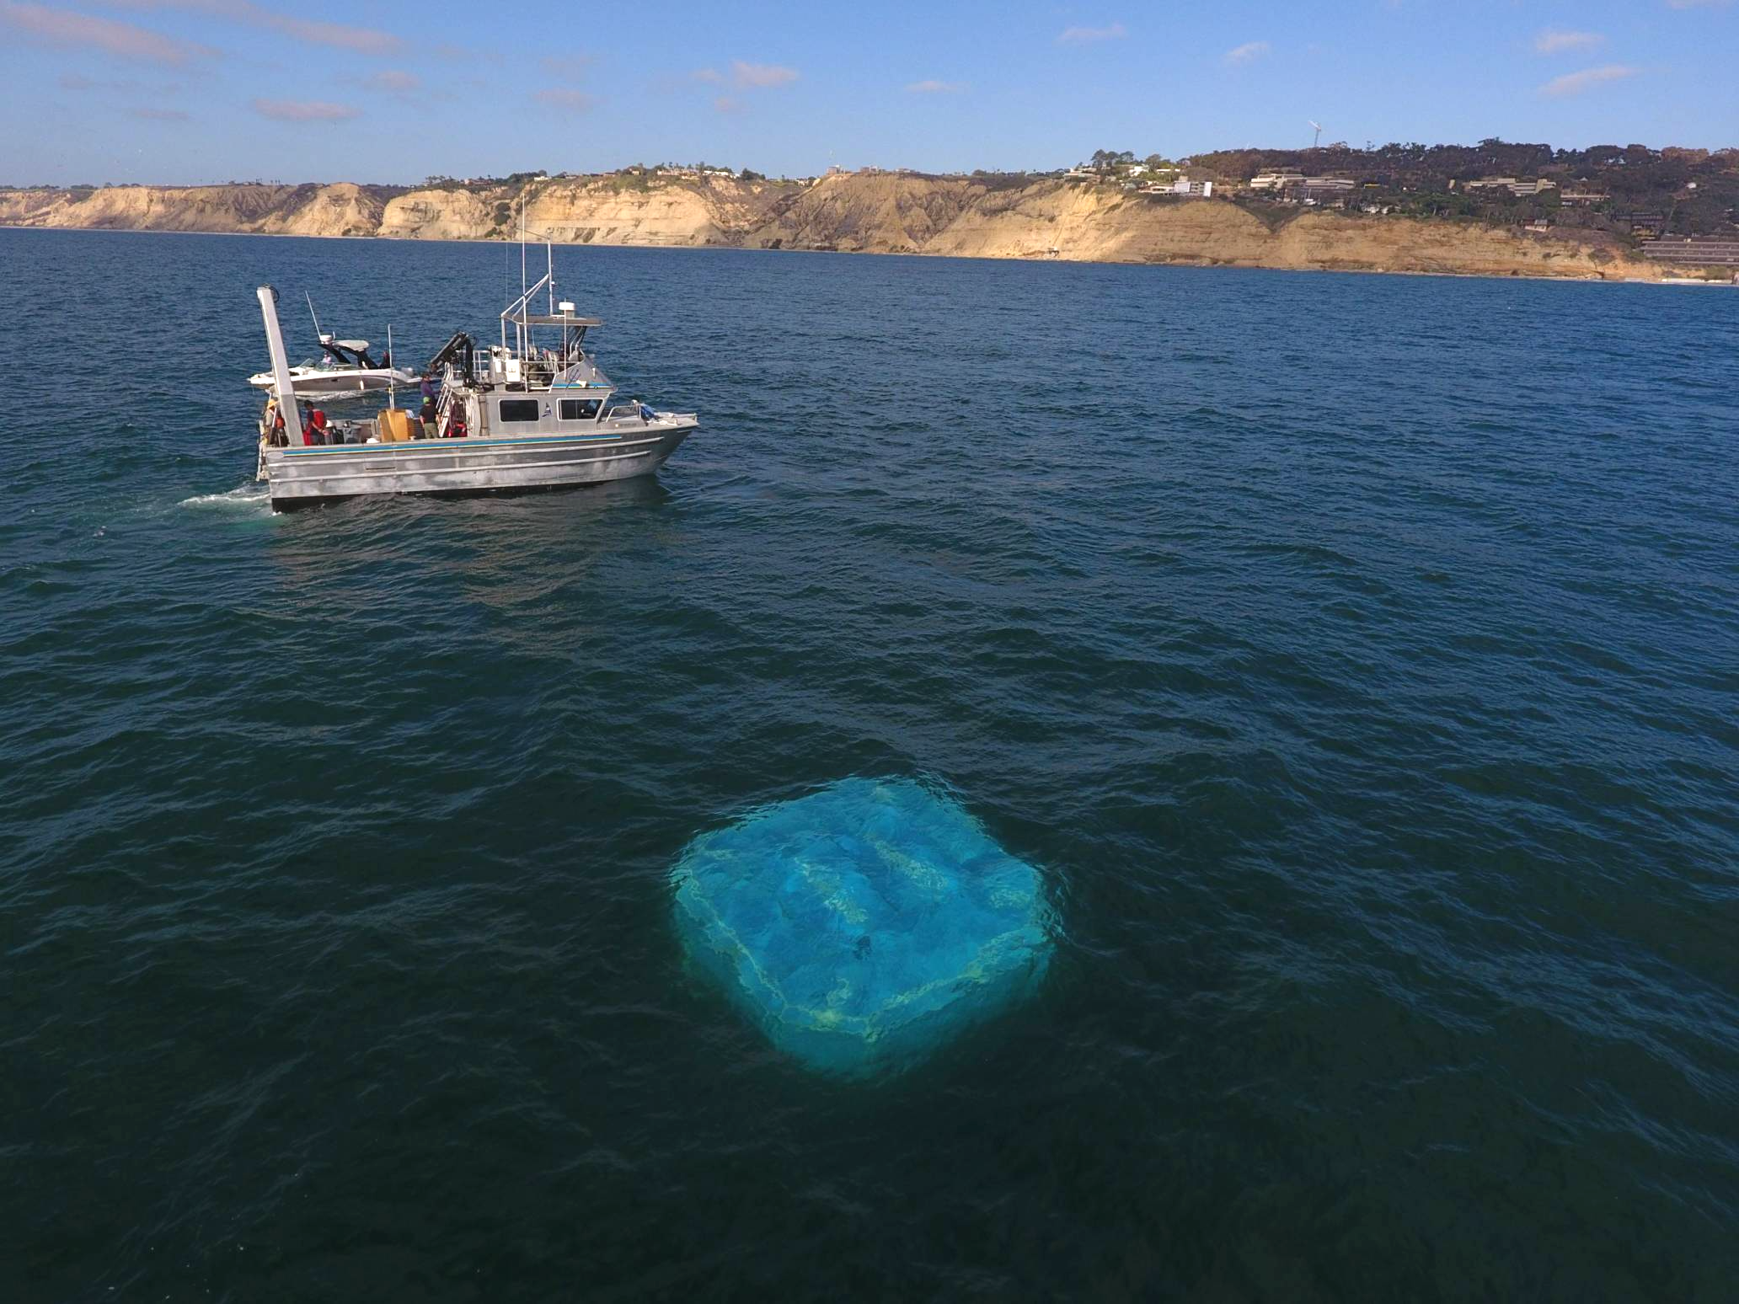
CalWave, California
Observations:
Mitigation and monitoring measures; what worked well what didn’t go to plan?
All monitoring efforts worked well. After around 8-months of continuous operation, the onboard external camera started to experience lens fogging and some vision obscuring from bio-growth. Gradual degradation of image quality/usefulness continued between months 8 and 10 of deployment.
Agreeing mitigation and monitoring measures; key challenges and lessons learned:
Due to the motion of the WEC being aligned with wave action, marine life appeared to move in unison with the WEC. No impacts were observed
Moving parts were largely self-cleaning as long they were exercised periodically
How mitigation and monitoring activities were funded; private, public, both?
Public (US DOE funding) + Private (cost share)

Slide 12
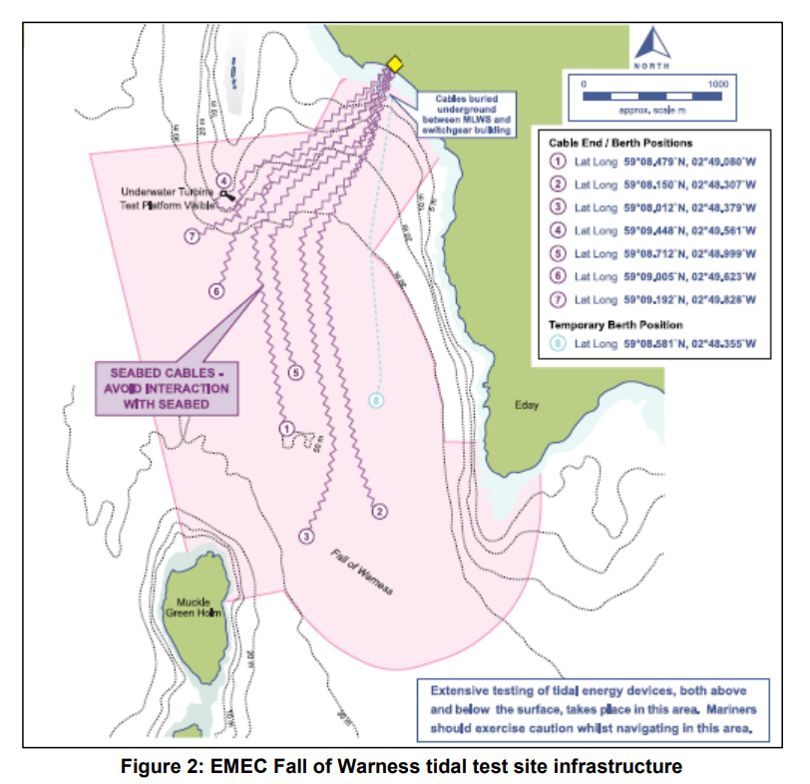
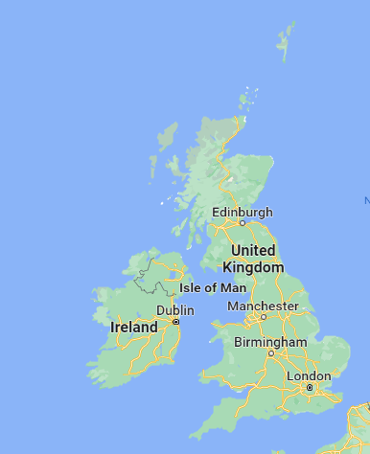
Voith Hydro, Orkney
Developer: Voith Hydro
Regulator: Marine Scotland
Location: EMEC tidal test area, Fall of Warness, Orkney
Generating capacity: 1 MW
Consent status: consenting completed in 2013 and reporting complete
Notes:
Voith installed their turbine at EMEC at a busy time for the test site, Openhydro, Atlantis, TGL/Rolls Royce were all installed at the site and a new cable was being laid.

Slide 13
Voith Hydro, Orkney
 | Mitigation Measures | Monitoring Measures | Reporting Requirements
Collision Risk | Turbine soft starts during commissioning Minimize turbine standstill | Underwater video monitoring to investigate near field behavior | Soft start ‘log’ (6 months)
Underwater Noise | Drilling soft start MMO during drilling (mitigation zone) | Acoustic monitoring: Drilling Vessel thrusters Above deck activities | MMO report and acoustic monitoring report (8 weeks)
Benthic Impacts | Pre-construction ROV survey | Post-construction ROV survey | Pre-construction report (prior to installation) Post-installation ROV report and ‘as built plan’ (28 days)
Other Notables | Vessel management plan agreed to reduce disturbance at seal haul outs | Seal haul out monitoring during installation activities | Environmental monitoring report (12 months)
Notes:
Comprehensive mitigation and monitoring plan was developed with the regulator and its statutory advisors
Voith were very keen to learn from the deployment and were very supportive of undertaking additional monitoring and research around the turbine
Quite a lot of attention at the time from the regulators on the impacts or large vessel (DP vessel) operations on marine wildlife, which resulted in some additional mitigation and monitoring work being undertaken
Also the first major drilling activity on the site so some mitigation and monitoring was undertaken during those operations including the establishment of a mitigation zone around the operations, which basically meant that if a marine mammal was spotted within 1km of the drilling site, operations could not start

Slide 14
Voith Hydro, Orkney
Observations:
Mitigation and monitoring measures; what worked well what didn’t go to plan?
Agreed not to undertake acoustic monitoring of vessel operations or drilling operations for future work
Agreed not to implement ‘soft starts’ during drilling or turbine operations during future deployments
Cameras worked well initially but 2/3 lenses became fouled quite quickly
Preparing the EMMP and agreeing mitigation and monitoring measures; key challenges and lessons learned:
Iterative process with the regulator and statutory advisors
Aided by existing consents at the site and agreement that the activities were at an established test site
Strong policy support for tidal energy development at the time
Clear distinction made between monitoring and supplementary research
EMMP agreed for project in two phases; monopile installation and device operation
How mitigation and monitoring activities were funded; private, public, both?
All activities funded by developer, vessel acoustic monitoring done by EMEC & Heriot Watt University
Notes:
Provides a good example of how a demonstration project or test programme can be used not only to look at technology performance, but also at how effective mitigation and monitoring measures are in helping to manage risks and uncertainties, with the results having a short term impact on other projects both at the same location and nationally

Slide 15
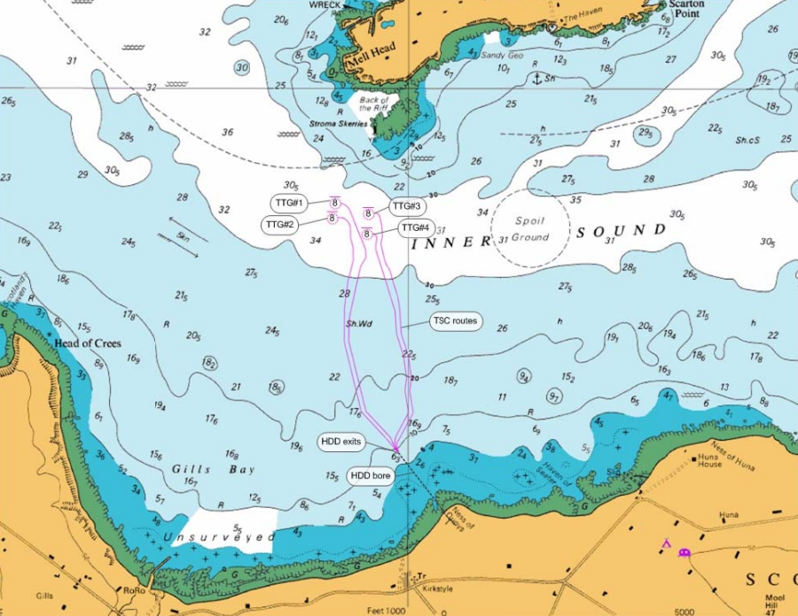
MeyGen, Pentland Firth
Developer: Atlantis Resources
Regulator: Marine Scotland
Location: Inner Sound, Pentland Firth, Scotland
Generating capacity:
Phase 1 – 6 MW installed to date
Phase 2 – additional 80 MW
Phase 3 – total 398 MW
Consent status: consent granted for up to 86 MW generating capacity, conditional on staged deployment
Notes:
EMMP for MeyGen, would very much have been informed by the work that had been undertaken at the EMEC test sites, including the Voith Hydro project

Slide 16
MeyGen, Pentland Firth
 | Mitigation Measures | Monitoring Measures | Reporting Requirements
Collision Risk | None | Survey, Deploy, Monitor Strategy, Marine Mammal Monitoring Programme, Seal Tagging, Shoreline monitoring, Active Acoustics | EMMP
Underwater Noise | None | Operational noise monitoring | EMMP
Benthic Impacts | Minimize footprint of foundation piles, minimize cable voltage to reduce EMF, increase length of drilled cables | Habitat monitoring, dispersion of drill cuttings during HDD | EMMP
Other Notables |  | Passive Acoustic Monitoring | PEMP

Slide 17
MeyGen, Pentland Firth
Observations:
Mitigation and monitoring measures; what worked well what didn’t go to plan?
Provided significant evidence of avoidance behaviour by harbour porpoise
New monitoring platform recently installed with St Andrews University
Preparing the EMMP and agreeing mitigation and monitoring measures; key challenges and lessons learned:
EMMP (or PEMP) agreed in consultation with a project steering group, consisting of the developer, regulator, advisors and the research/monitoring teams
Project was instrumental in demonstrating the ‘survey, deploy and monitor’ approach
Key challenge in mapping out how data collected during phase 1 could be used in scaling up the project (consents and monitoring plan design)
How mitigation and monitoring activities were funded; private, public, both?
Combination of private, public and research funding (significant resources the Scottish Demonstrator Project to support collision risk research)

Slide 18
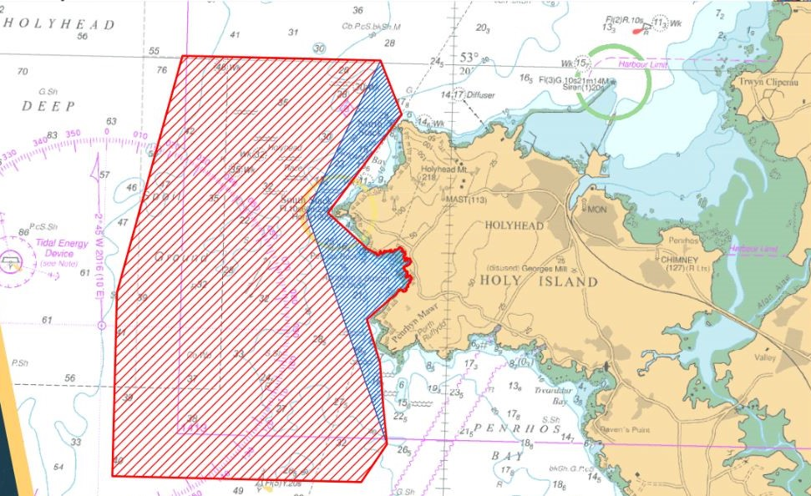
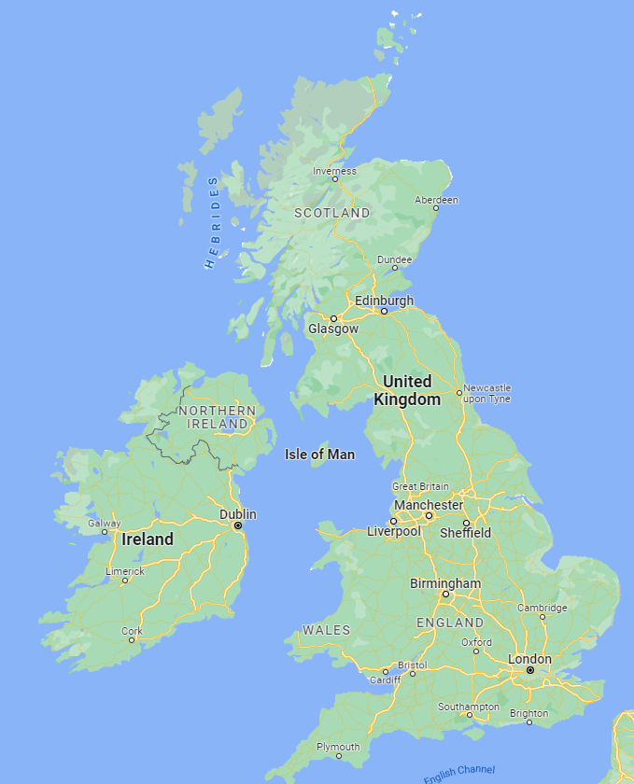
Anglesey Marine Energy: Morlais
Developer: Menter Môn (not for profit, 3rd sector)
Regulator: Natural Resources Wales
Location: 35 km² area of seabed off the coast of Holy Island, Anglesey (within the West Anglesey Demonstration Zone (WADZ))
Generating capacity: 240 MW
Consent status: consent was awarded in December 2021.

Slide 19
Anglesey Marine Energy: Morlais
 | Mitigation Measures | Monitoring Measures | Reporting Requirements
Collision Risk | ADDs, Visual deterrents | PAM, Active Sonar, Surface/UW Cameras, VP survey, colony counts | TBC. EEMP in development
Underwater Noise | MMMP | Noise quantification & spatial distribution | TBC. EEMP in development
Benthic Impacts | Precon surveys/micrositing | None | None
Other Notables | TBC in EEMP | TBC in EEMP | TBC

Slide 20
Anglesey Marine Energy: Morlais
Observations:
Mitigation and monitoring measures; what worked well what didn’t go to plan?
n/a – project in pre-development
Preparing the EMMP and agreeing mitigation and monitoring measures; key challenges and lessons learned:
Work in progress! Outline EMMP agreed during the consenting process, Advisory Group established and a detailed EMMP for Phase 1 is being developed.
Priority questions and indicators agreed with the Advisory Group
Baseline data and other technical work programmes are underway
How mitigation and monitoring activities were funded; private, public, both?
Morlais has secured funding from WEFO to support the design of the EMMP (including baseline data collection, equipment trials etc), which has allowed the engagement of an extensive team of experts to support the design work.

Slide 21
Best Practices
What drives specific monitoring data collection and analysis needs around a deployed device?
Based on the marine animals/habitats at risk, based on what the developer and regulator agrees upon
Existing knowledge
Specific interactions:
For tidal/river/ocean current only: potential risk or collision or close encounter
Underwater noise from the operational device
Electromagnetic fields from the power export cable
Changes in benthic habitats, changes in pelagic habitats
Whatever your regulator determines (!)
Notes:
Based on the marine animal and habitat resources you and your regulator has agreed are at risk.
For tidal: risk or collision (or close encounter) with rotating blades, for marine mammals, fish, diving seabirds, sea turtles, as appropriate for the site.
Underwater noise from the operational device.
Electromagnetic fields from the power export cable, and perhaps the operational device.
Changes in benthic habitat from anchors or foundations and along the cable route. Changes in pelagic habitat from additions of mooring lines in the water column and floats on or under the surface.
Whatever your regulator determines (!)

Slide 22
Best Practices
What information can help focus these monitoring efforts?
Collision risk: ongoing monitoring. Research on instruments needed, models to be refined and validated.
Underwater noise: collected for WECs and turbines, using IEC TC114 standards, perhaps using US regulatory action levels for marine mammals and fish.
EMF: emissions from cables and devices related to the amount of power carried by the cable and the configuration of the cable. Appears to be of little concern.
Changes in benthic and pelagic habitats: can be understood from other offshore industries. Siting is important.
Notes:
Collision risk will likely entail some ongoing monitoring. Active research continues to answer questions in this area, but the concern remains, no matter how unlikely a collision might seem.
Underwater noise has been collected for a number of WECs and turbines. Using IEC TC114 standards, it appears that for small numbers of devices (1-4), this risk falls below US standards and guidelines for marine mammals and fish, resulting in no significant risk. OES-E considers the risk to be retired for small numbers of devices.
EMF emissions from cables and devices is related to be amount of power carried by the cable and the configuration of the cable. Although there are no definitive conversions for cable configurations, we know that the amount of power carried by marine energy devices is small. Laboratory assessments do not consider these levels of EMF to cause significant harm to benthic or pelagic animals. OES-E considers the risk to be retired for small numbers of devices.
Changes in benthic and pelagic habitat can be gleaned from effects from other offshore industries including oil and gas, offshore wind, and any development at sea. While a good seabed survey is essential, it is most important to site marine energy devices so they do not affect fragile (endangered, threatened, unique) habitats. OES-E considers the risk to be retired for small numbers of devices.

Slide 23
Best Practices
Are there other types of information that might be needed?
Changes in sedimentation patterns or water circulation
Displacement of migratory patterns or movements of marine animals
Research can best address these and other issues at array scale
Notes:
Regulators may be curious about whether your device or array might change sedimentation patterns or water circulation. For small numbers of devices, this is not measurable and OES-E considers the risk to be retired. For larger arrays, numerical models can provide the best answers at the moment.
Similarly, small numbers of devices are unlikely to change migratory patterns or movements of marine animals. Potential effects of large arrays are uncertain.

Slide 24
Best Practices
How can we deliver this information for the good of the sector?
Agree on priority information needed
Consensus around strategic research
How we can deliver this research

Slide 25
Best Practices
 | Sensor | Energy Environment | Data Products | Receptor
Collision Risk | Multi or single frequency sonar | Tidal, riverine | Mean biomass as a function of depth, tidal state, time of day; abundance of species; fish tracks | Fish, marine mammals
 | Acoustic and video cameras | Tidal, riverine | Number of animals over unit time in sampled volume | Fish, marine mammals
 | Hydrophone/click detector | Tidal, riverine | Presence/absence of vocalizing marine mammals and automated click detector | Marine mammals and some fish
 | Acoustic doppler current profiler | Tidal, riverine | Tidal velocity data for correlation with biological data | Auxiliary data
Underwater Noise | Hydrophone | Wave, tidal, riverine | Sound pressure data, spectral levels, RMS sound pressure | Marine mammals and some fish
 | Acoustic doppler current profiler | Tidal, riverine | Current data and wave data | Informs acoustic environment
 | Anemometer | Wave, tidal, riverine | Wind speed/direction | Informs acoustic environment
 | Conductivity, Temperature, Depth (CTD) | Wave, tidal, riverine | Sound speed data | Acoustic environment
Changes in Habitat | Sediment sampler | Wave, tidal, riverine | Sediment size, infauna diversity/abundance, organic/pollutant content | Sediment, infauna
 | Remotely operated vehicle | Wave, tidal | Sediment composition, epifauna/pelagic diversity/abundance along transects | Sediment, epifauna, demersal
 | Drop-down camera | Wave, tidal, riverine | Sediment composition, epifauna diversity/abundance in quadrats | Sediment, epifauna
 | 360-degree camera | Wave, tidal | Epifauna/pelagic diversity/abundance on/around foundations and anchors | Epifauna, demersal
Electromagnetic Fields | Towed magnetometer | Wave, tidal, riverine | Spatially interpolated 2D scalar magnetic field – cables and devices | Invertebrates, some fish
 | Fixed station magnetometer | Wave, tidal, riverine | Time-varying scalar magnetic field strength – devices | Invertebrates, some fish
 | Electric field sensor | Wave, tidal, riverine | Time-varying electric field strength – devices | Invertebrates, some fish

Slide 26
Research to Support Consenting, Successful Projects
Focus on information gaps based on regulator needs
Focus on interactions with greatest uncertainty
Consider monitoring for scale of project (single device versus arrays)
Consider regional requirements (such as European Directives)
Global Research Fund

Slide 27
Notable Processes
Risk retirement, data transferability, guidance documents (add URLs)
Management measures (aka mitigation)
ORJIP Information notes (Wales)
Upcoming:
Case Studies (examples) of applying data transferability to risk retirement
Regulator workshops – December 6th
3:00pm UTC: https://pnnl.zoomgov.com/meeting/register/vJItdumvrz4pGL5Ca7AoTfjoi223eZhYf9s
12:00am UTC: https://pnnl.zoomgov.com/meeting/register/vJItde6uqzwtHIES-jzs3fW4gU8FJx7Ssrg
Workshop for developers (?)
Critical evidence gaps, summary of ORJIP Forward Look

Slide 28
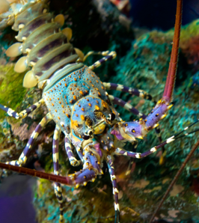
Next Steps
Global Research Fund note
Update critical evidence needs for global context
Prepare guidance note around the development of monitoring and mitigation plans
Include guidance into 2024 State of Science
Enhanced collaboration and exchange between monitoring and research teams

Slide 29
Survey
Please fill out our short survey!

Slide 30
Thank you!
Andrea Copping
andrea.copping@pnnl.gov
Ian Hutchison
ian.hutchison@aquatera.co.uk

